Slide 1
INTERNSHIP PRESENTATI ON
Internship Review 2
Monday,April 22st/2024

Slide 2
Abstract
This paper presents the design and implementation of an inventory management system developed using C# programming language and Microsoft Access database. The system aims to streamline inventory management processes for small to medium-sized businesses by providing efficient tracking, monitoring, and control of inventory items.
The system allows Owner to add, update, and delete inventory items, along with their relevant details such as name, description, quantity, and price.
The system seamlessly integrates with a billing module to generate invoices and print bills for completed orders, providing a comprehensive solution for inventory and sales management.
The system is developed using C# programming language for its robustness and flexibility, while Microsoft Access database is utilized for its ease of use and compatibility with small-scale applications. The graphical user interface (GUI) is designed to be intuitive and user-friendly, facilitating easy adoption and minimal training requirements for end-users.

Slide 3
Enhance user experience through an intuitive graphical user interface (GUI) and seamless integration with existing workflows.
Ensure scalability, reliability, and security to support the long-term growth and sustainability of the system.
Need and Significance of Proposed System :
The need for a more efficient and robust inventory management system is evident. The proposed system aims to address the limitations of the existing methods by leveraging the power of technology to streamline inventory-related processes. By automating tasks such as inventory tracking, order processing, and reporting, the proposed system seeks to optimize resource utilization, minimize errors, and improve overall operational efficiency.
The significance of the proposed system lies in its potential to transform the way businesses manage their inventory. By providing accurate, real-time insights into inventory levels, sales trends, and customer preferences, the system empowers businesses to make informed decisions, reduce stockouts, and enhance customer satisfaction. Moreover, the system's integration with billing functionality offers a seamless end-to-end solution for inventory management and sales processing.

Slide 4
Introduction
In today's fast-paced business environment, effective inventory management is crucial for the success and sustainability of any organization. Manual inventory tracking systems often prove to be inefficient and error-prone, leading to operational inefficiencies, increased costs, and missed business opportunities. To address these challenges, the implementation of automated inventory management systems has become imperative.
Objectives :
The primary objectives of this project are as follows:
Design and develop a comprehensive inventory management system using C# programming language and Microsoft Access database.
Implement features such as inventory tracking, order processing, reporting, and billing to meet the diverse needs of businesses.

Slide 5
Requirement analysis
Requirement analysis is a critical phase in the development of any software project, including an inventory system with bill printing functionality. It involves gathering, documenting, and analyzing the needs and expectations of stakeholders to ensure that the final product meets their requirements effectively. Here are some key aspects of requirement analysis for this project:
Functional Requirements: Identify the core functionalities that the inventory system must provide, such as:
Inventory Management: Adding, updating, and deleting inventory items.
Order Processing: Creating, editing, and fulfilling orders, with automatic inventory updates.
Reporting: Generating various reports like inventory status, sales analysis, etc.
Billing Integration: Seamless integration with billing functionality to print bills for completed orders.
Non-Functional Requirements: Consider non-functional aspects like performance, security, usability, and scalability:
Performance: Ensuring the system operates efficiently even with large volumes of data.
Security: Implementing user authentication and authorization mechanisms to protect sensitive information.
Usability: Designing an intuitive user interface to facilitate easy navigation and operation.
Scalability: Ensuring the system can accommodate future growth and expansion of the business.

Slide 6
User Requirements: Understand the needs and preferences of end-users, including:
User Roles: Identifying different user roles and their corresponding permissions within the system.
User Interface Preferences: Gathering feedback on user interface design preferences and usability requirements.
Training and Support: Assessing the need for training materials and ongoing support for users.
Technical Requirements: Determine the technical environment and constraints for the system:
Programming Language and Database: Choosing C# for development and Access database for storage.
Hardware and Software Dependencies: Identifying hardware and software requirements for deploying the system.
Integration Requirements: Assessing integration points with external systems, such as billing software for printing bills

Slide 7
Data Flow Diagram
Customer Management
Payment Managemet
Inventory System
Inventory Management
Receiving Stock
Management
Purchasing Management
Supplier
Management

Slide 8
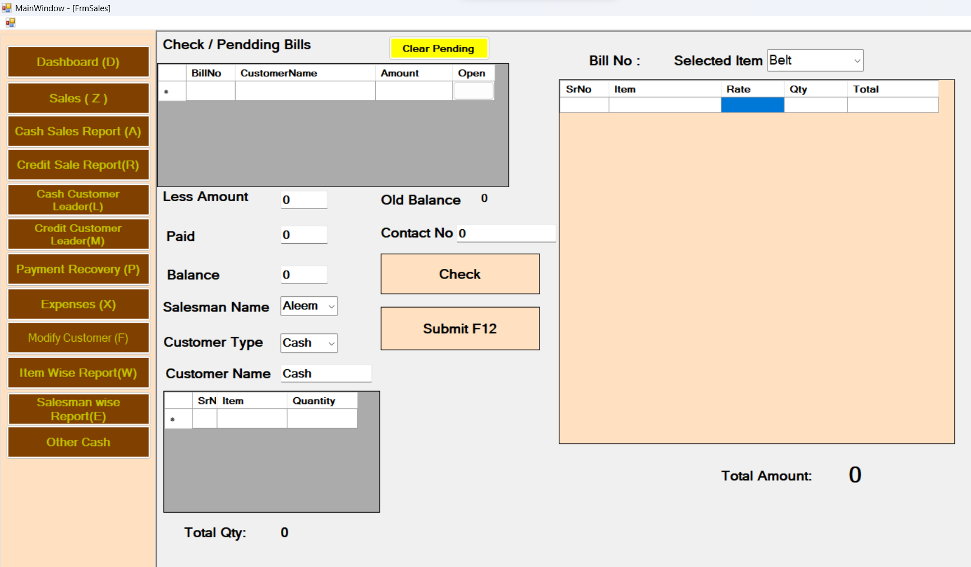
This is the Front Page of My project :
In This page first we insert the item which customer buy and write name of item , Rate ,and Quantity . After that we click on the Check button so the data is insert the database and in said the Thermal Printer give the print bill. In this case we use then SQL statement like insert and we also write code for print .

Slide 9
We use this code for insert the all detail of Sale
cmd.CommandText = "insert into Sales (SalesID,SDate,CustomerType,CustomerName,Discount,TotalAmount,PaidAmount,BalanceAmount,TotalItem,TotalQty,status,DailyBillNo,OldBalance,Salesman) values("+sid+",#" + DateTime.Now + "#, '" + txtCustType.Text + "','" + txtCustName.Text + "', " + txtDiscount.Text + " ," + txtTotalAmt.Text + "," + txtPaid.Text + "," + balance + ",0, '0','Submit'," + dd + "," + txtoldBal.Text + ",'" + txtSalesman.Text + "')";
cmd.ExecuteNonQuery();
We Use this code for insert all data about Item
cmd.CommandText = "insert into SalesItem (SaleID,Product,Unit,Qty,Rate,Total) values(" + sid + ", '" + dataGridView1[1, r].Value + "', 'Nos', " + dataGridView1[3, r].Value + ", " + dataGridView1[2, r].Value + "," + dataGridView1[4, r].Value + ")";
cmd.ExecuteNonQuery();

Slide 10
This code for Print the Bill int startX = 10; int startY = 5; int Offset = 20; graphics.DrawString("Ismail General Store", new Font("Courier New", 12, FontStyle.Bold), new SolidBrush(Color.Black), startX, startY + Offset); Offset = Offset + 20; graphics.DrawString("Chelipura Aurangabad", new Font("Courier New", 10), new SolidBrush(Color.Black), startX + 20, startY + Offset); Offset = Offset + 20; graphics.DrawString("Mo: 9373897717 ", new Font("Courier New", 10), new SolidBrush(Color.Black), startX + 30, startY + Offset); Offset = Offset + 20; String underLine = "------------------------------------------"; graphics.DrawString(underLine, new Font("Courier New", 10), new SolidBrush(Color.Black), startX, startY + Offset); Offset = Offset + 20;

Slide 11
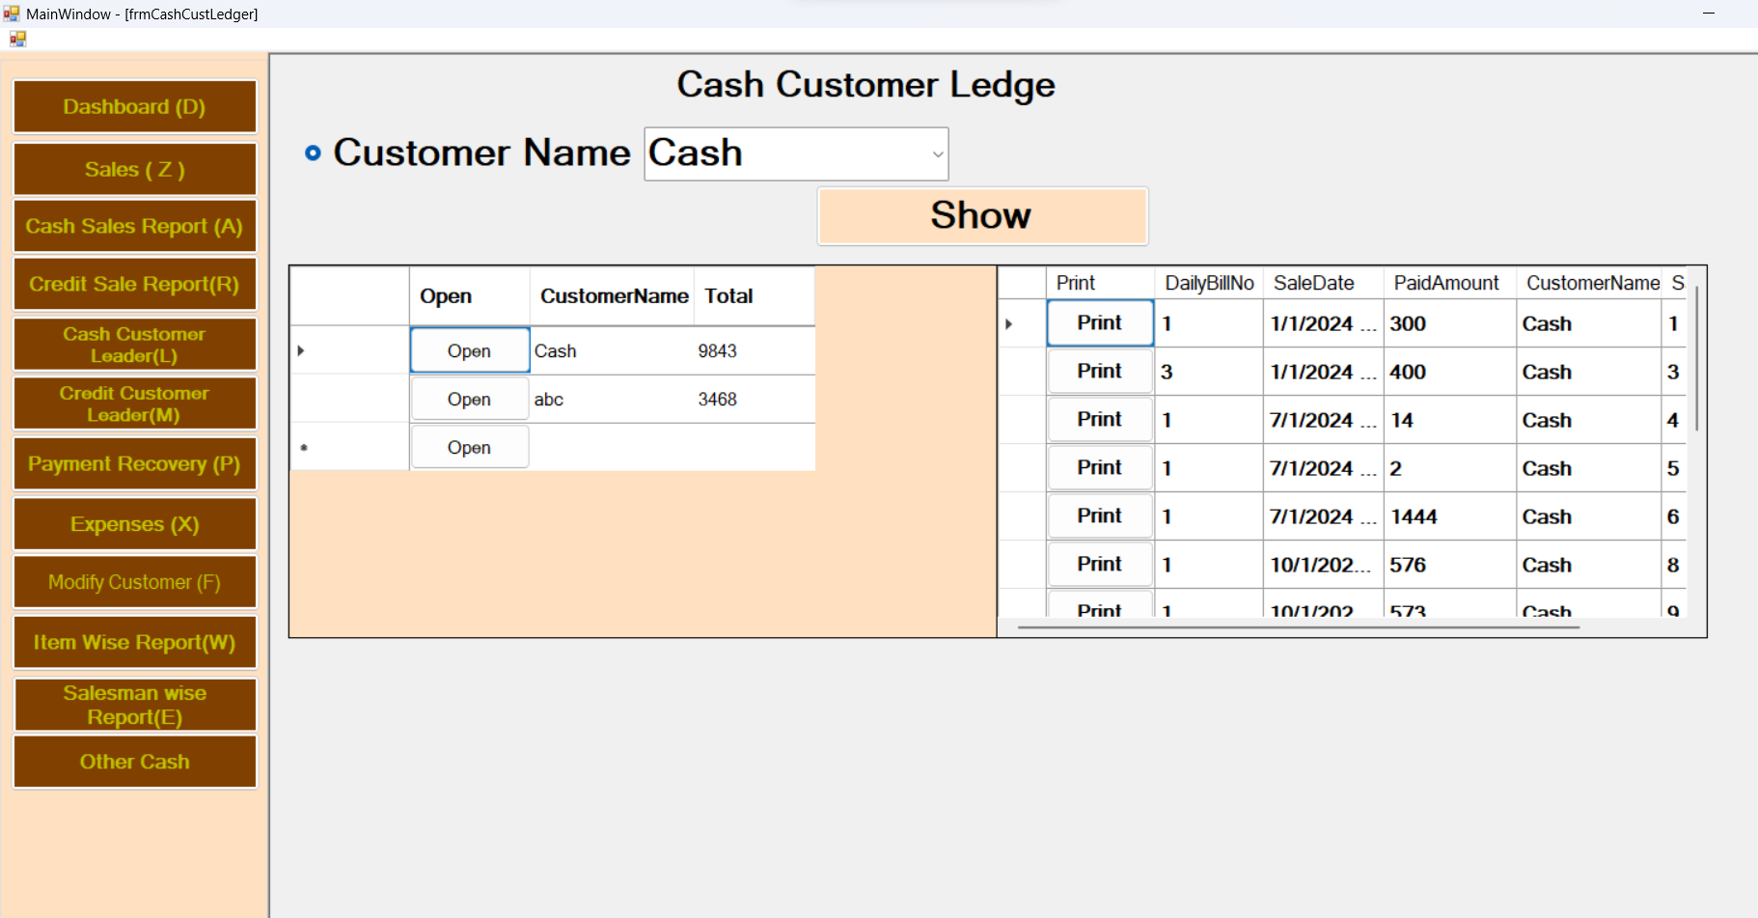
This the Customer Ledge Form

Slide 12
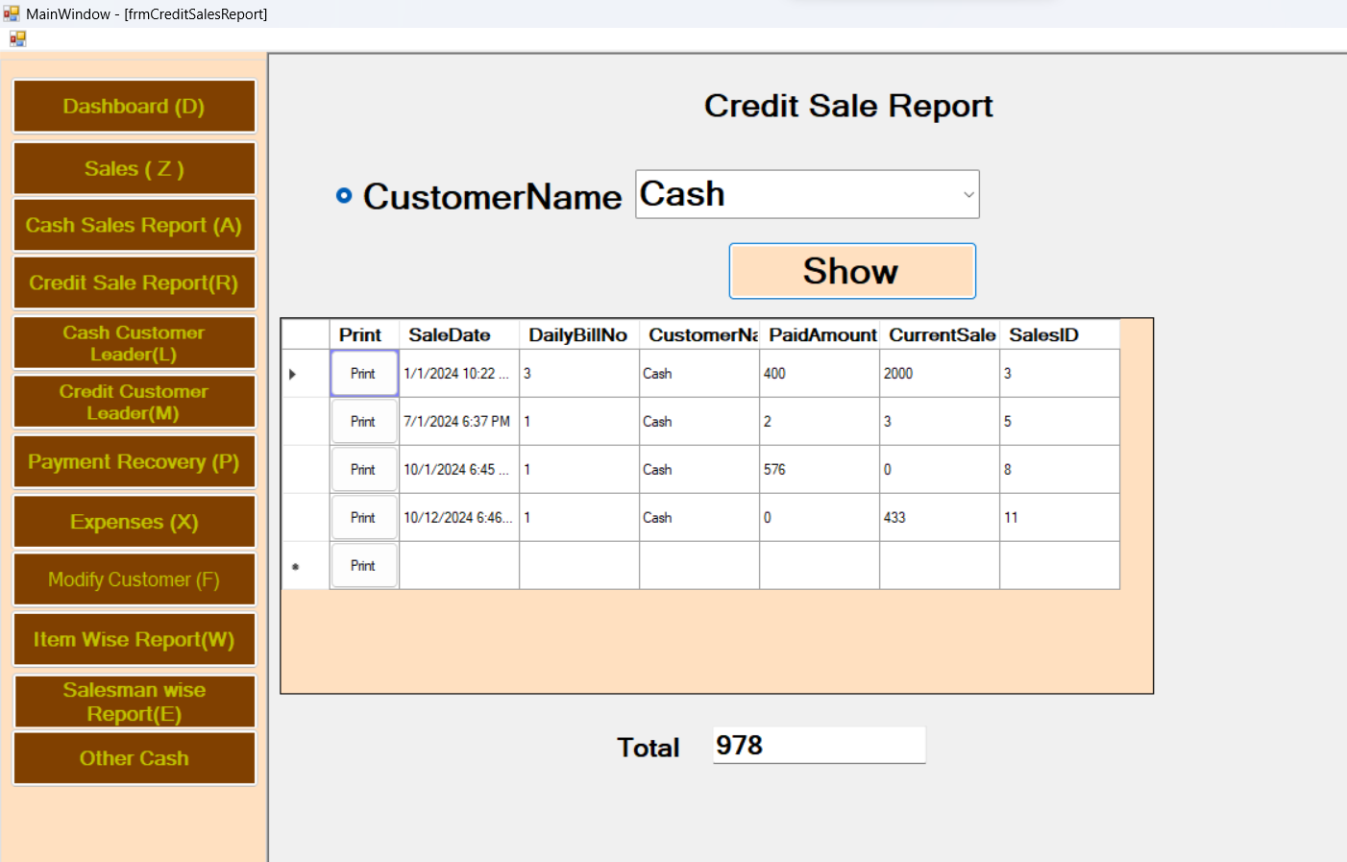
This is Credit Sale Report

Slide 13
KEY LEARNINGS
We are learning many lessons during internship period, the most important ones are :
To work in team, Coordinate.
How to work professionally.
Cost , Time , and Quality must be evaluated at all times.
Importance to develop a coding mechanism (habit) in order to generate error free code as much as possible.
Think creatively to generate ideas.
Focusing on weak side .

Slide 14
Learning Outcomes
Learning different languages , Tools and frameworks for full stack
web development.
Working on multiple tasks at same time.
Learning about the how E-commerce website and business like how does it work.
Learning how Technology is used in solving business problem.
Learning how to work in an industry environment with deadlines.
And most importantly how to present our work to client.

Slide 15
Conclusion: In the fast-paced automotive industry, the need for streamlined operations and enhanced customer experiences is paramount. The development and implementation of a Customer Management Inventory System tailored for garage settings stand as a pivotal step toward revolutionizing the way automotive service centers operate. By amalgamating cutting-edge technology with industry-specific functionalities, this system aims to address the unique challenges faced by garage owners and managers. Through meticulous database management, streamlined inventory control, and personalized customer service, the system promises an array of benefits: • Enhanced Efficiency: Centralized data management and streamlined workflows optimize operational efficiency, reducing redundancies and minimizing manual errors. • Customer-Centric Approach: Comprehensive customer profiles, service histories, and personalized interactions foster stronger relationships and increased customer satisfaction. • Informed Decision-Making: Data-driven insights generated through robust reporting and analytics empower stakeholders to make informed decisions, driving business growth and strategy. This Customer Management Inventory System represents not only a technological advancement but a strategic investment in the future of garage operations. By prioritizing efficiency, customer satisfaction, and data-driven decision-making, it promises to elevate the standards of service within the automotive repair industry. ________________________________________ In conclusion, the integration of this system into garage operations signifies a paradigm shift toward a more efficient, customer-centric, and future-ready approach, positioning garages to thrive in an increasingly competitive landscape.

